Slide 1
Low-Code, Rapid, Cross-Platform .NET App Development with DevExpress
Overview
Đà Nẵng, 11/2022 Lê Minh Thái

Slide 2
Demo of Completed Application

Slide 3
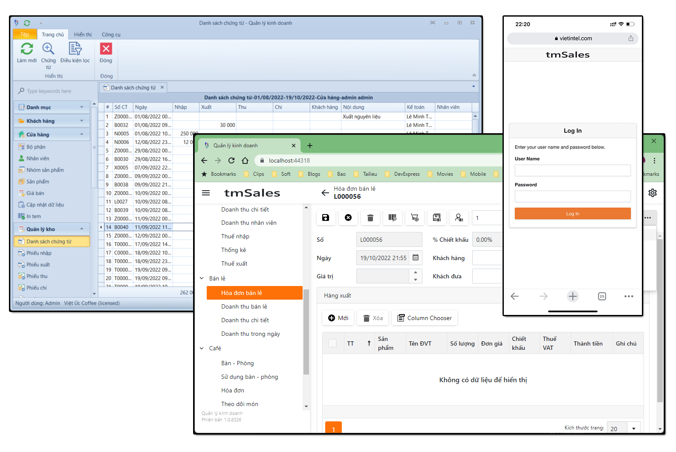
Demo
URL:
vietintel.com
Account:
guest
No password

Slide 4
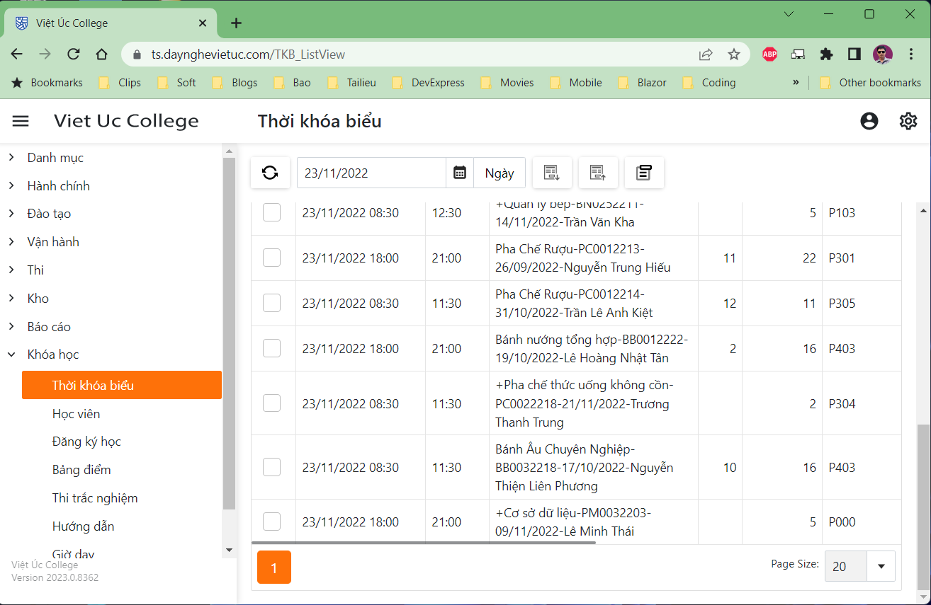
Demo
URL:
ts.daynghevietuc.com
Account:
guest
No password

Slide 5
XAF Overview

Slide 6
contents
Overview
Application Solution Structure
Creating Business Objects
XPO vs EF
Persistent Objects
XAF Application Model
Creating Controllers
ViewControllers vs WindowControllers
Interacting with Views, Frames, and ObjectSpaces

Slide 7
contents
Creating Actions
Simple Actions
Single Choice Actions
Popup Window Show Action
Parameterized Actions
Using the [Action] Attribute
Reviewing Features and Modules
Language / Localization
Conditional Appearance, View Variants, and other Modules
WebAPI
Deployment
Desktop App
Blazor App

Slide 8
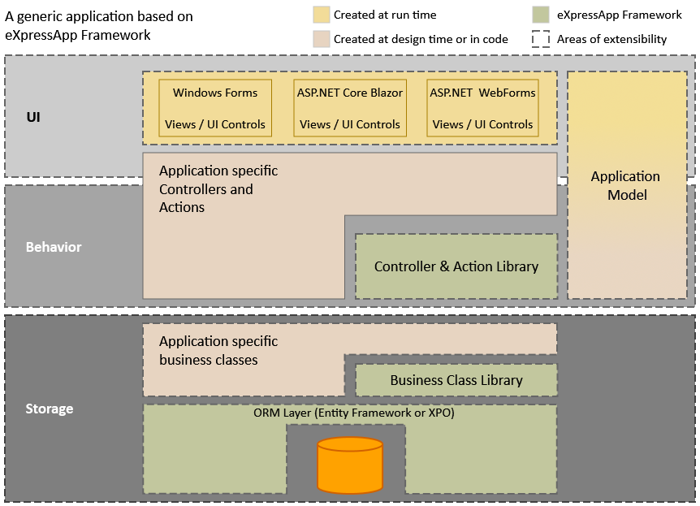
Overview
Plug-in MVC Architecture

Slide 9
Overview
ORM (Object-Relational Mapping) Layer
eXpressPersistent Objects (XPO)﻿
Entity Framework Core﻿
ORM tools allow you to use familiar code structures (classes, properties, and their attributes) to describe data for your application:
To create a data table, declare a class.
Class’ public properties define data fields in the data table.
The actual data set is a collection of class instances.
To specify relations between tables, decorate classes and properties with specially designed attributes.

Slide 10
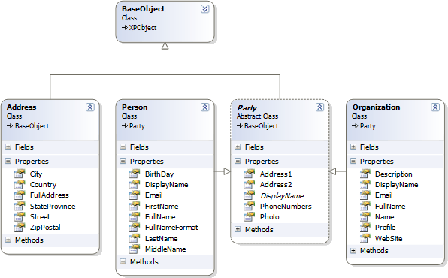
Overview
Business Class Library
The Business Class Library implements the following:
Classes that define frequently used entities.
Interfaces that you may need to implement in your data classes.

Slide 11
Overview
User Interface (UI)
eXpressApp Framework separates business logic from the application’s visual representation. XAF can creates the following UIs based on the same business logic:
A desktop application: a WinForms application (for the .NET Framework or .NET 6)
A web application: an ASP.NET Core Blazor application (for .NET 6 solutions) or ASP.NET Web Forms application (for the .NET Framework)
Additional Modules
You can add the following modules to your XAF app:
Modules shipped with XAF (Security, Reports, Dashboards, Office, Charts, Maps, etc).
Third-party modules.
Your own custom modules.

Slide 12
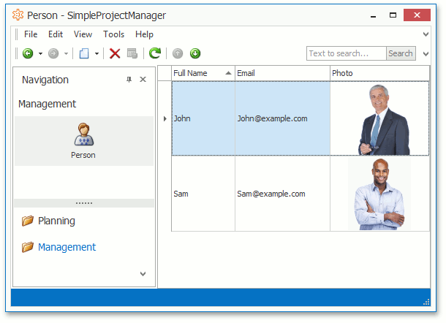
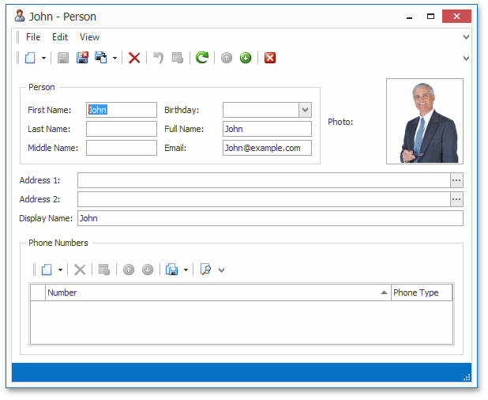
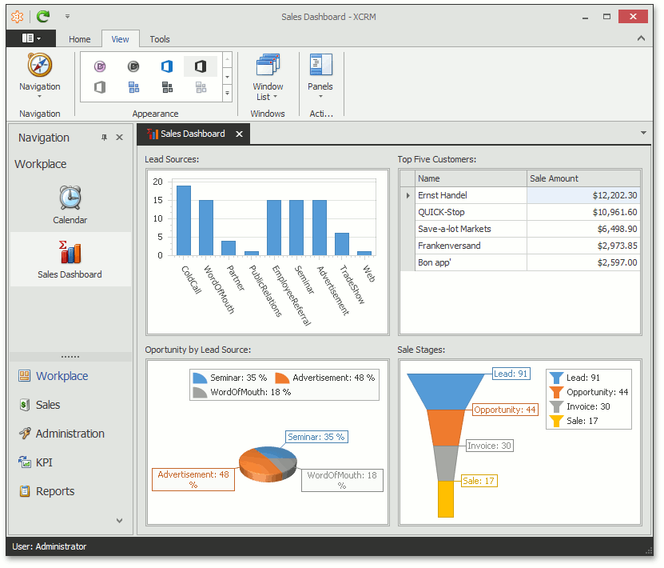
Overview
Views
List View
Detail View
Dashboard View

Slide 13
Overview
Behavior
Built-in Controllers
Controllers are objects that manage your application flow. They are also responsible for end-user interaction. Even the simplest applications built with the eXpressApp Framework use a number of built-in Controllers supplied with the System Module and Additional Modules. These default Controllers are mostly responsible for data management. With their help, you can add new records, delete existing ones, perform full text search, etc.
Your own Controllers and Actions
Application Model
The Application Model stores all the information to build the XAF application UI.
You can use the Model Editor to edit the Application Model in both design time and runtime (*.xafml - XML format).

Slide 14
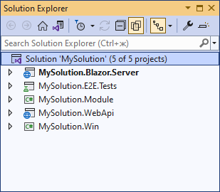
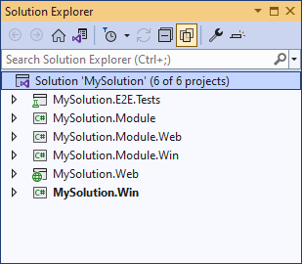
Application Solution Structure
.NET 6+:
WinForms, ASP.NET Core Blazor, and Web API applications + End-to-End/Functional test project Using XAF Solution Wizard
.NET Framework 4.5.2+:
WinForms and ASP.NET Web Forms applications + End-to-End/Functional test project

Slide 15
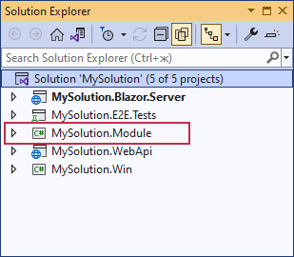
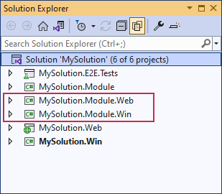
Application Solution Structure
Projects
Main Module Project (.NET Framework & .NET 6+)
To implement UI-independent application elements (Business Model, Controllers)
Platform-Specific Module Projects (.NET Framework)
implement custom platform-specific Controllers, Property Editors, and other elements for your WinForms or ASP.NET Web Forms application

Slide 16
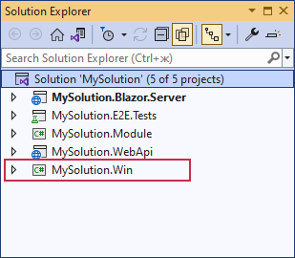
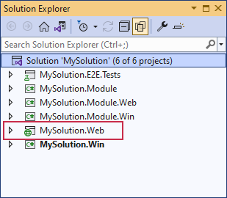
Application Solution Structure
Projects
WinForms Application Project (.NET Framework & .NET 6+)
Contains code specific to your application’s WinForms version.
If your solution includes the platform-specific module project, add business classes, editors, and Controllers to this project instead of the application project.
ASP.NET Web Forms Application Project (.NET Framework)
Contains code specific to your application’s ASP.NET Web Forms version.

Slide 17
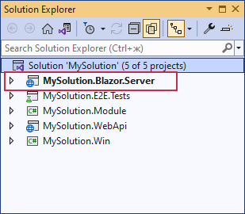
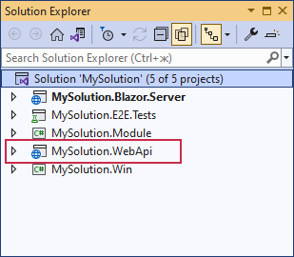
Application Solution Structure
Projects
ASP.NET Core Blazor Application Project (.NET 6+)
Contains code specific to your application’s ASP.NET Core Blazor version.
If your solution includes the platform-specific module project, add business classes, editors, and Controllers to this project instead of the application project.
Web API Application Project (.NET 6+)
Contains Web API settings
End-to-End/Functional Test Project (.NET Framework & .NET 6+)
Contains predefined configuration for end-to-end (functional) tests. In this project, you can write C#/VB.NET functional tests for your XAF applications.

Slide 18
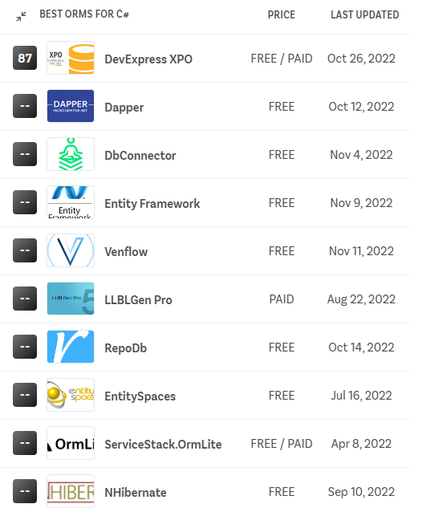
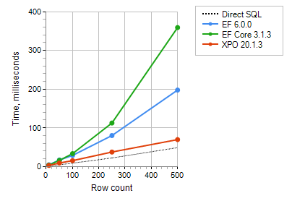
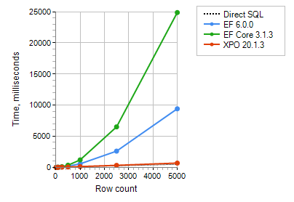
Creating Business Objects
XPO vs EF
.NET Core ORM Benchmark
InsertOne Method
Small Data Set
Large Data Set

Slide 19
Creating Business Objects
Persistent Object
PersistentBase
XPBaseObject
XPObject
XPLiteObject
XPCustomObject
Relationships Between Objects
One-to-Many Relationships
One-to-One Relationships
Many-to-Many Relationships
public partial class Contact : XPLiteObject {
int fContactKey;
[Key(true)]
public int ContactKey
{
get { return fContactKey; }
set { SetPropertyValue<int>(nameof(ContactKey), ref fContactKey, value); }
}
string fFirstName;
[Size(50)]
public string FirstName
{
get { return fFirstName; }
set { SetPropertyValue<string>(nameof(FirstName), ref fFirstName, value); }
}
string fLastName;
[Size(50)]
public string LastName
{
get { return fLastName; }
set { SetPropertyValue<string>(nameof(LastName), ref fLastName, value); }
}
public Contact(Session session) : base(session) { }
}

Slide 20
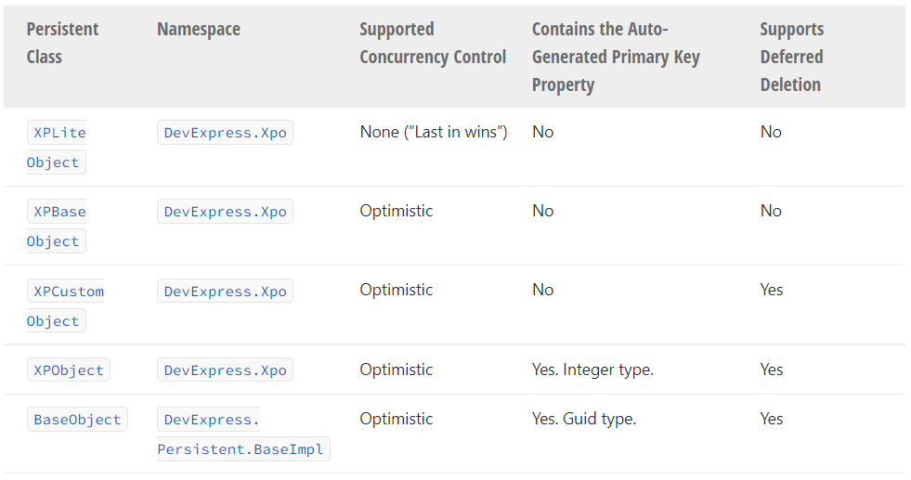
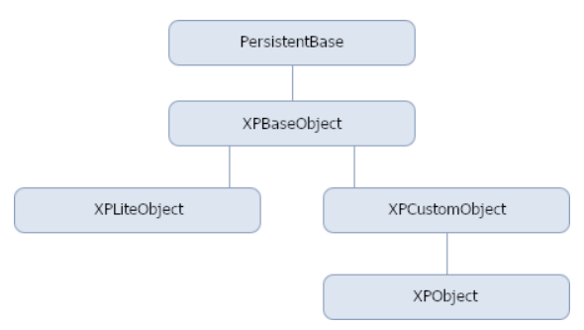
Creating Business Objects
XPO Classes Comparison

Slide 21
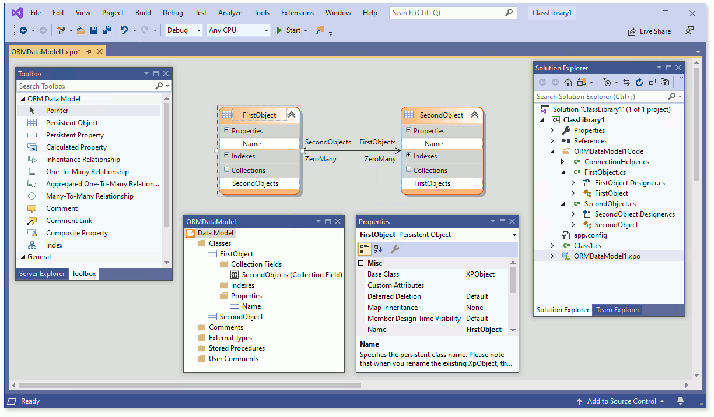
Creating Business Objects
Data Model Designer

Slide 22
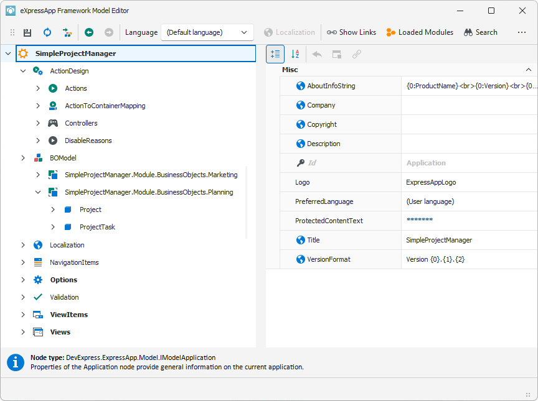
Creating Business Objects
XAF Application Model
navigation structure,
data presentation formats
available commands

Slide 23
Creating Controllers
Two main purposes:
Perform specific actions when a Window (Frame) is created or destroyed.
When a Window (Frame) is created, all the Controllers that are intended for it are activated (Controller.Activated). You can handle these events to implement features related to the current Window (Frame) or its View.
When a Window (Frame) is disposed of, its Controllers are deactivated (Controller.Deactivated). This allows you to perform specific actions when closing a Window or disposing of a Frame.
Extend the user interface.
In most cases, features demand end-user interaction. For this purpose, Controllers can serve as containers for Actions. Actions are objects that represent abstract UI elements, and can be displayed in a UI using actual controls: a button, combo box, submenu, etc. To respond to an end-user’s manipulations with an action control, handle the corresponding Action’s events.
Controllers classes:
ViewController
ViewController<ViewType>
ObjectViewController<ViewType, ObjectType>
WindowController

Slide 24
Creating Controllers
View Controllers
View Controllers are activated for both Windows and Frames when a View is set to a Window/Frame.
Main ViewController‘s properties:
ViewController.TargetViewType
Specifies the View type: List View, Detail View or any View. By default, the value of this property is Any.
ViewController.TargetViewNesting
Specifies whether the current Controller is allowed to be activated for the root View, nested View or any View. By default, the value of this property is Any.
ViewController.TargetObjectType
Specifies the type of a persistent object displayed by the View.
ViewController.TargetViewId
Specifies the View ID. This ID is specified in the Application Model.

Slide 25
Creating Controllers
View Controllers
using DevExpress.ExpressApp;
using DevExpress.Persistent.BaseImpl;
// ...
public class MyViewController : ViewController {
public MyViewController() : base() {
TargetObjectType = typeof(Person);
TargetViewType = ViewType.ListView;
}
protected override void OnActivated() {
base.OnActivated();
// Perform various tasks depending on the target View.
View.CustomizeViewItemControl(this, MyMethod);
}
private void MyMethod(ViewItem viewItem) {
// Access and customize the target View control.
}
protected override void OnDeactivated() {
// Unsubscribe from previously subscribed events and release other references and resources.
base.OnDeactivated();
}
}

Slide 26
Creating Controllers
Window Controllers
Window Controllers are activated when a Window or a Frame is created, and intended for implementing features for Windows, i.e., features that are not related to specific Views.
Window Controllers are activated for Windows only. You can additionally specify the Window type for which the Controller will be activated.
Controller’s WindowController.TargetWindowType property:
Any
Main
Child

Slide 27
Creating Controllers
Window Controllers
using DevExpress.ExpressApp;
using DevExpress.ExpressApp.SystemModule;
// This Controller changes a caption in a main application window
public class CustomizeWindowController : WindowController {
public CustomizeWindowController() {
TargetWindowType = WindowType.Main;
}
protected override void OnActivated() {
base.OnActivated();
WindowTemplateController controller = Frame.GetController<WindowTemplateController>();
controller.CustomizeWindowCaption += Controller_CustomizeWindowCaption;
}
private void Controller_CustomizeWindowCaption(object sender, CustomizeWindowCaptionEventArgs e) {
e.WindowCaption.Text = "My Custom Caption";
}
protected override void OnDeactivated() {
base.OnDeactivated();
WindowTemplateController controller = Frame.GetController<WindowTemplateController>();
controller.CustomizeWindowCaption -= Controller_CustomizeWindowCaption;
}
}

Slide 28
Creating Controllers
Implement Custom Controllers
If a Controller, together with its Actions, is UI-independent, it should be implemented in a Module project.
At the same time, there may be a UI-specific task. In this instance, a Controller should be developed in a UI-specific Module.
If your solution does not contain this project, implement it in an application project.

Slide 29
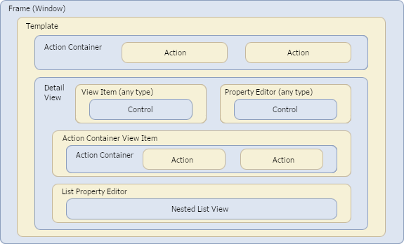
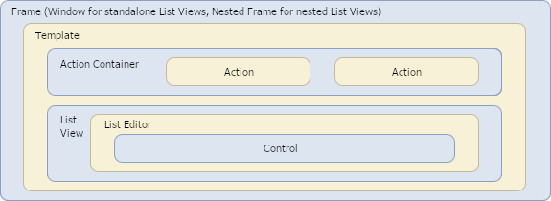
Creating Controllers
Interacting with Views, Frames, and ObjectSpaces
Detail View
List View and Nested List View
XAF creates Object Spaces for each View in an application

Slide 30
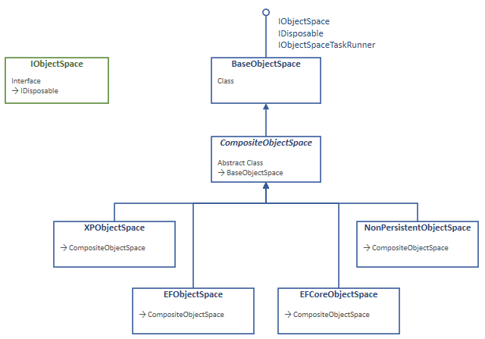
Creating Controllers
ObjectSpaces
Database Context for CRUD Operations.
Allows you to query or modify data in the transaction.
XAF creates Object Spaces for each View in an application.

Slide 31
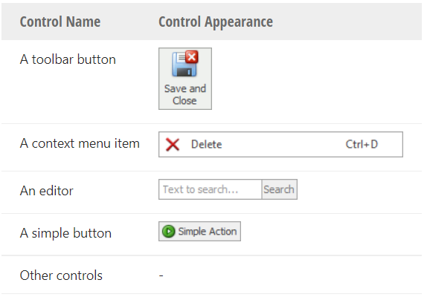
Creating Actions
Action Definition
Actions are abstract UI elements that allow end-users to interact with XAF applications.
Action Types
XAF Actions can be of different types:
SimpleAction
PopupWindowShowAction
ParametrizedAction
SingleChoiceAction
ActionUrl
Using the [Action] Attribute
You can also create custom Action types and custom controls.

Slide 32
Reviewing Features and Modules
Language / Localization
Use the Localization Service to download satellite assemblies
Conditional Appearance
allows you to configure a user interface dynamically.
UI customizations are performed on the basis of predefined business rules.
Security
Roles
Users
Audit Trail (History of Data Changes)
logs information on changes made to the persistent objects and stores this information in the application database.
You can retrieve information on a specific change type, the author of this change, the modified object, and the previous and new property values
Reporting

Slide 33
Reviewing Features and Modules
Backend Web API Service / REST API
You can use OAuth2, JWT or custom strategies for authentication.
The Web API creates URLs (endpoints) that allow you to perform CRUD operations from your non-XAF UI applications (for instance, .NET MAUI, JavaScript or Blazor clients).
It uses ASP.NET Core OData 8.0﻿ (OData v4.0) to support paging, filters, and other OData options.
This service can be hosted as part of a Blazor Server project or as a standalone ASP.NET Core project.
The Web API utilizes Swagger (OpenAPI)﻿ to display and test endpoints. You can also test endpoints or consume the Web API with other platforms (for example, Postman﻿, .NET, or JavaScript).

Slide 34
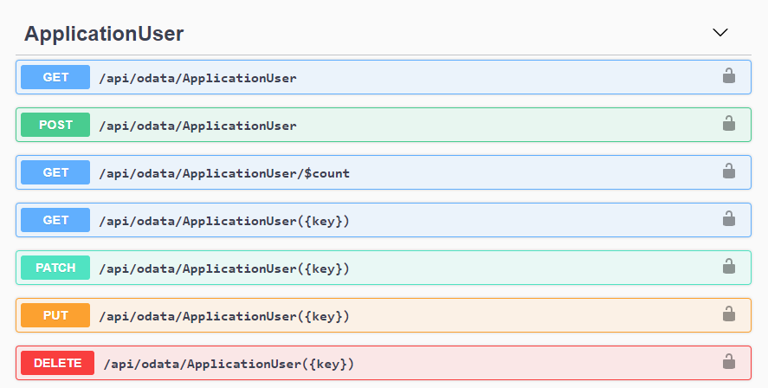
Reviewing Features and Modules
Backend Web API Service / REST API

Slide 35
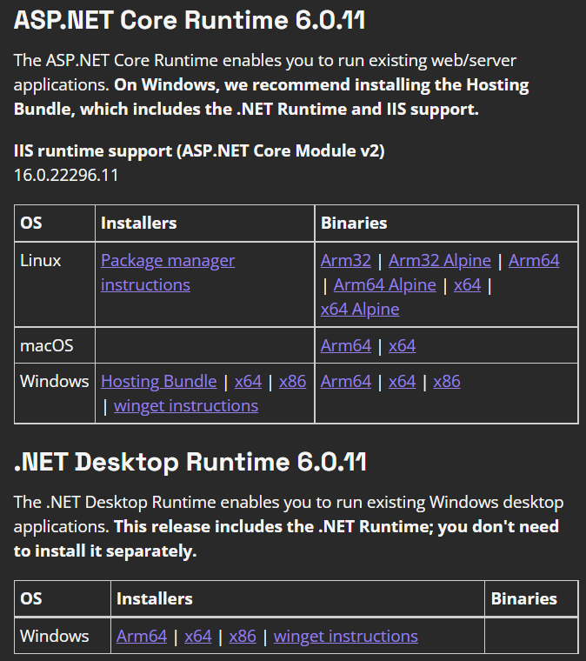
Deployment
Tools
DevExpress Assembly Deployment Tool
.Net Framework App
Visual Studio Publish
NET 6 App
Desktop App:
Portable
NET 6 Desktop Runtime
Blazor Web Server:
IIS
NET 6 Hosting Bundle

Slide 36
Appendix
Documentation
https://docs.devexpress.com/
.NET Core ORM Benchmark
https://github.com/DevExpress/XPO/tree/master/Benchmarks

Slide 37
Live Examples

Slide 38
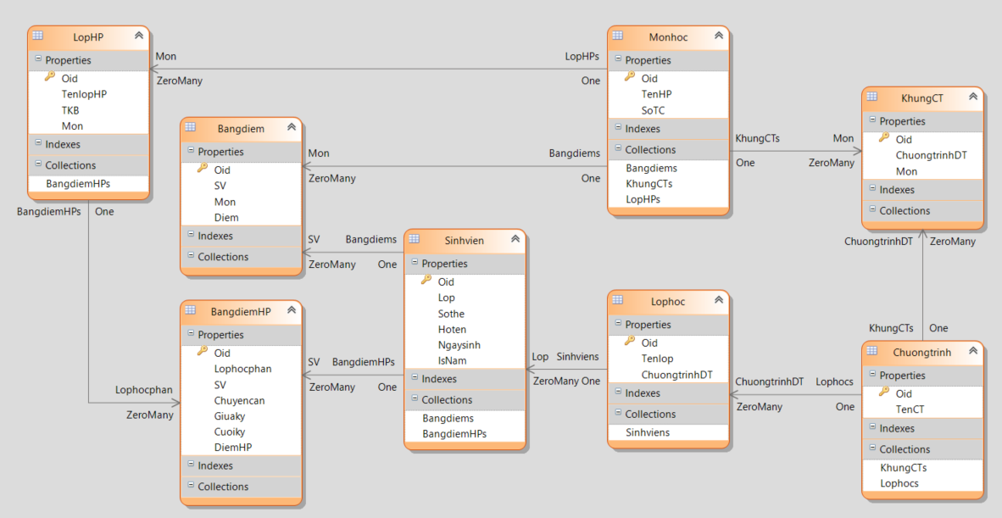
Live Examples
Training Project: “Quản lý điểm”

Slide 39
Live Examples
Steps
Create Persistent Classes
Create Relationships Between Objects
Customize Models
Create Controllers & Actions
Create Reports

Slide 40
Q & A

